Slide 1
The best historians:

Slide 2


…make clear judgements and present them as arguments
A historical ARGUMENT is simply a JUDGEMENT supported by evidence to give it substance and weight. The best historians also:
don’t just HIGHLIGHT their own point of view
but also DOWNPLAY the arguments of others

Slide 3
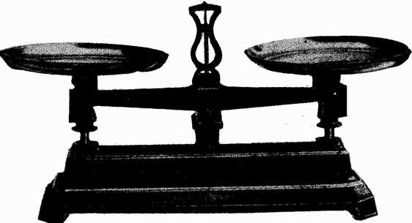
…make judgements and arguments by focussing on significance
causes
events
They do this by weighing up different elements of a given narrative or time period
changes
individuals
consequences

Slide 4

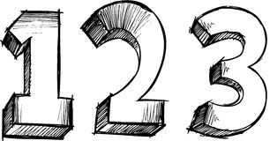
…communicate their ideas really clearly
In debates, the best historians develop their ideas as a sequence of points
In writing, historians develop written arguments as a SEQUENCE OF PARAGRAPHS
Each point or paragraph explores a new topic and is supported by ACCURATE and RELEVANT DETAIL

Slide 5


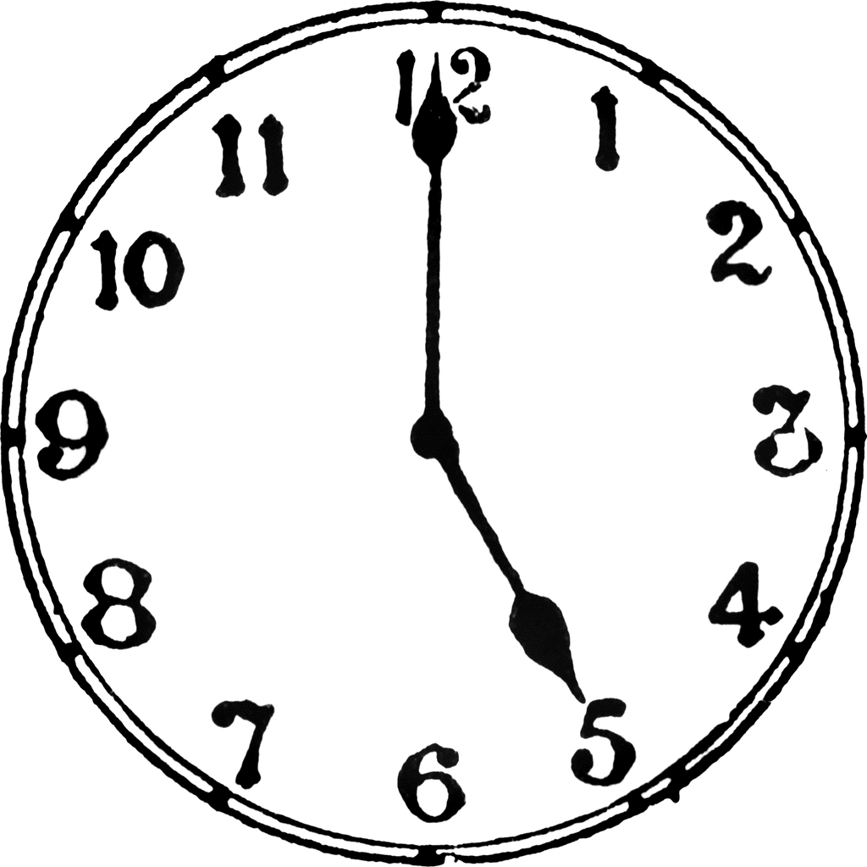
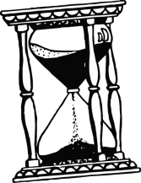

…understand the importance of chronology
Historians know that the order things happened in really is important
They know that the world changes over time, and events happen in an order
The best historians have an excellent sense of the period they investigate

Slide 6
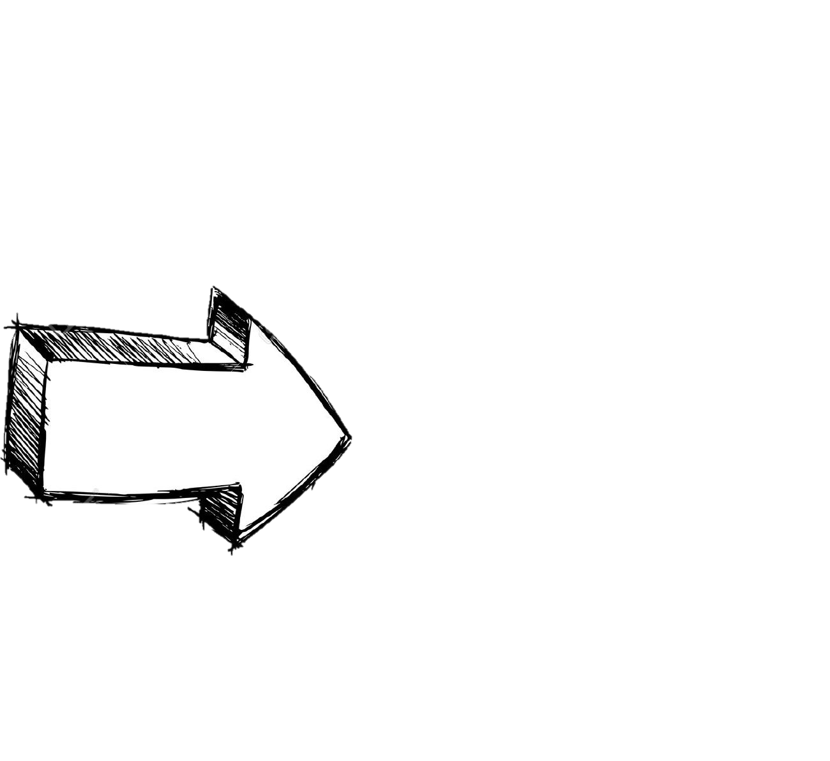

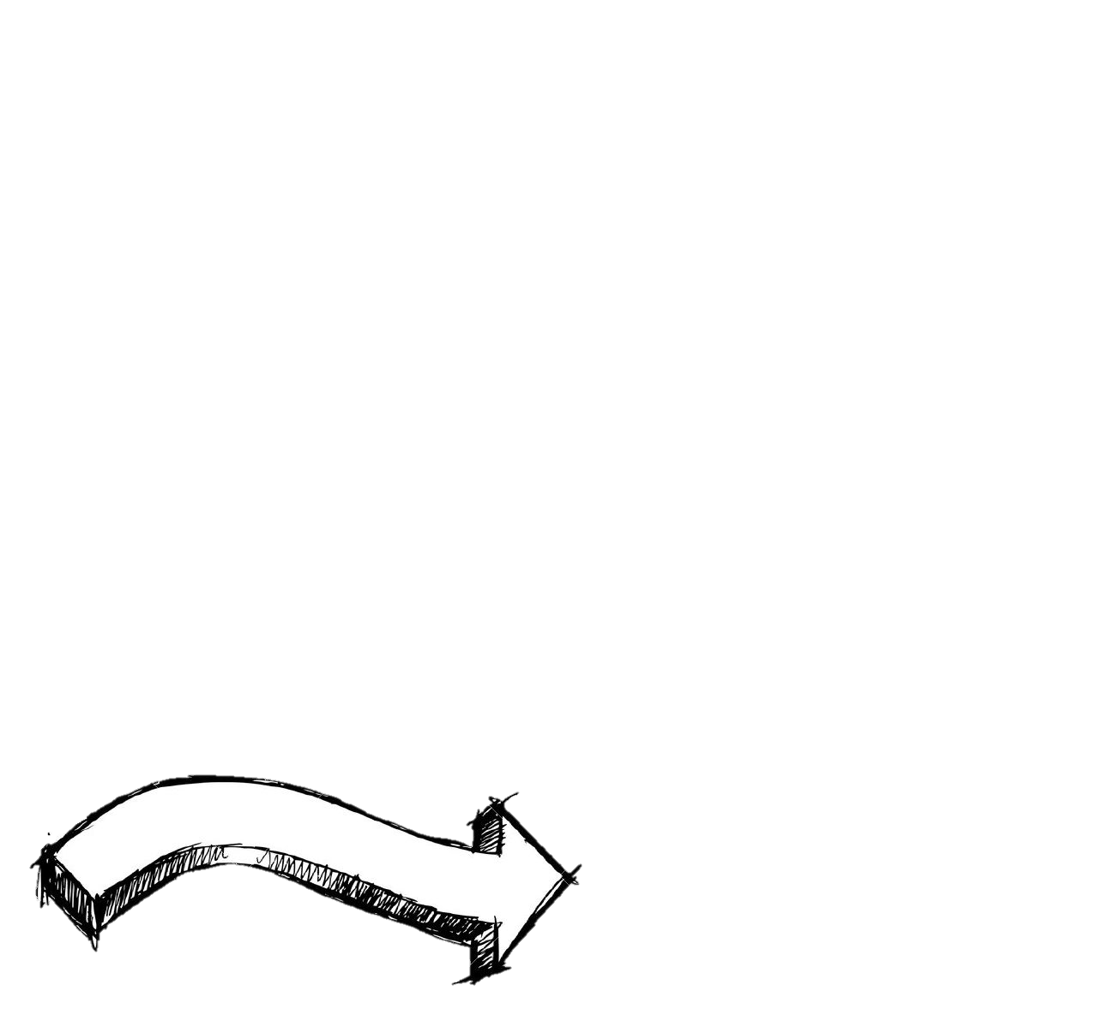
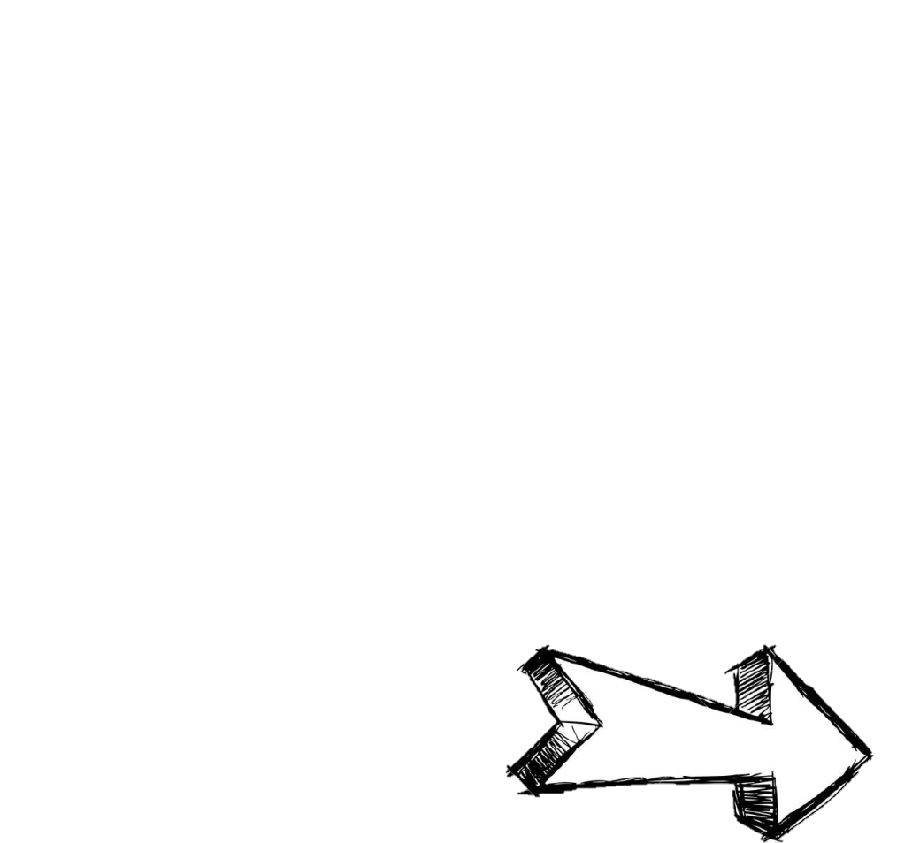

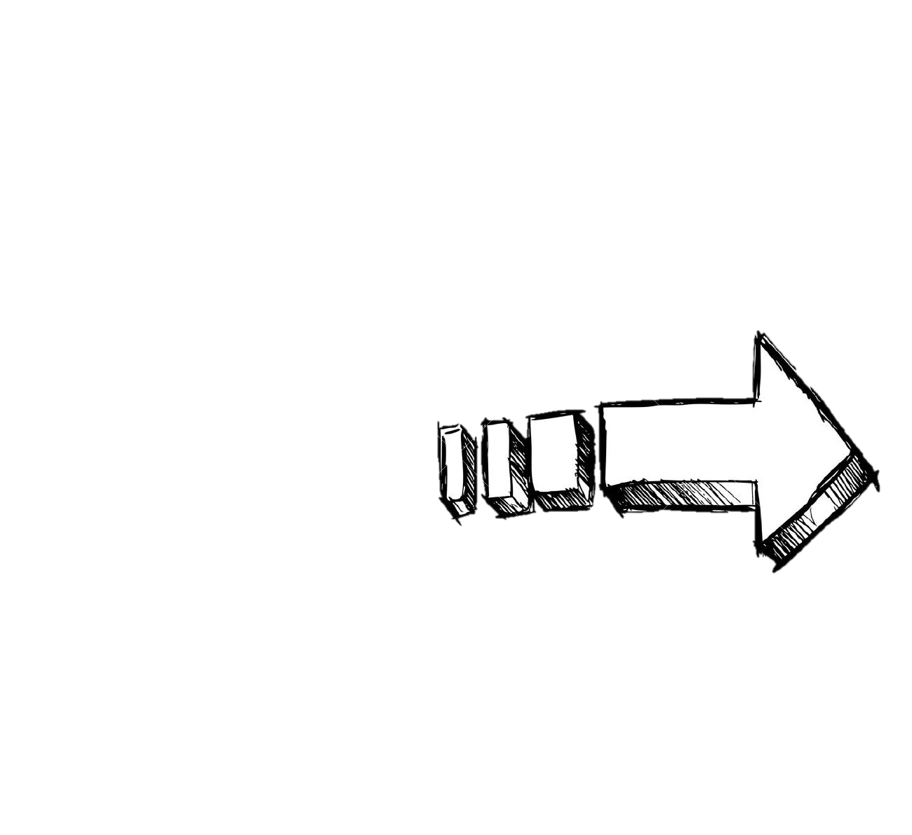
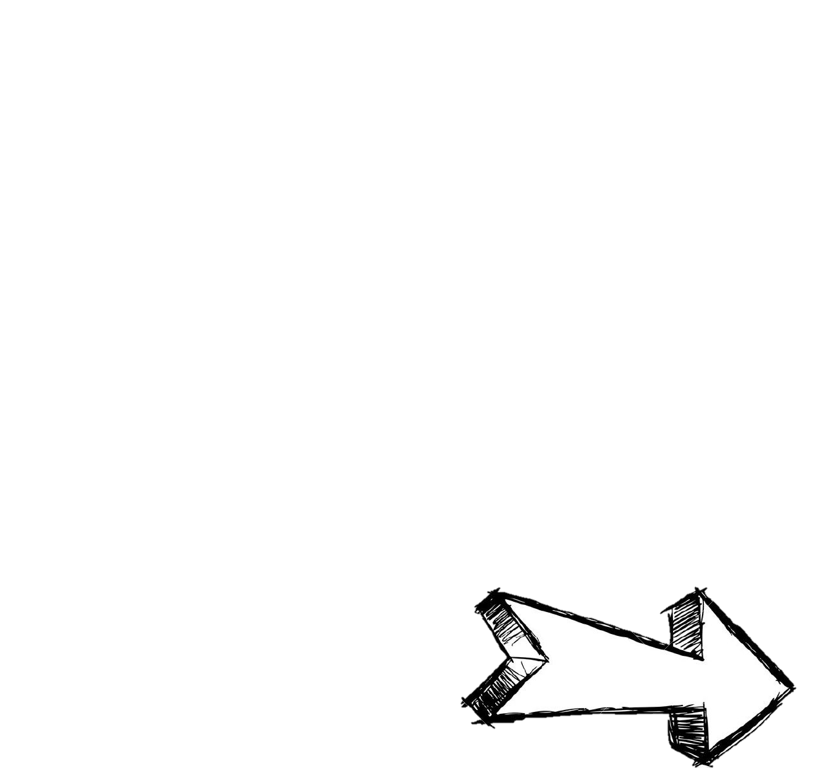
Causes
have different
LEVELS OF
INFLUENCE
…know that
causation is
complex
Causes always LINK TOGETHER to make change happen
SHORT-TERM
There are often
Change happens because of MULTIPLE CAUSES
causes
&
LONG-

Slide 7

Consequences can be
…are very careful with consequences
DIRECT
or
INDIRECT
LONG-
There are often
&
SHORT-TERM
Events must be LINKED TOGETHER for one to be a consequence of the other
consequences
Consequences are sometimes only seen with HINDSIGHT

Slide 8
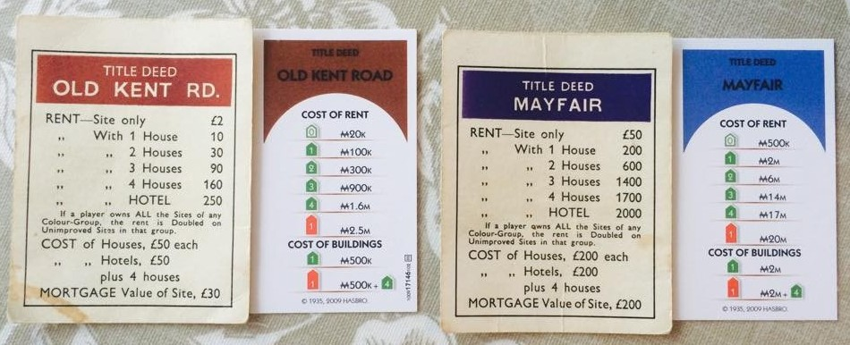


…actively look for similarities and differences
Historians know that different PEOPLE experienced events and time periods in different ways
Historians look to identify WHAT is different as well as WHY it is different.
They understand how different
CONDITIONS
can create
OUTCOMES
different
Notes:
More than just shapes?

Slide 9





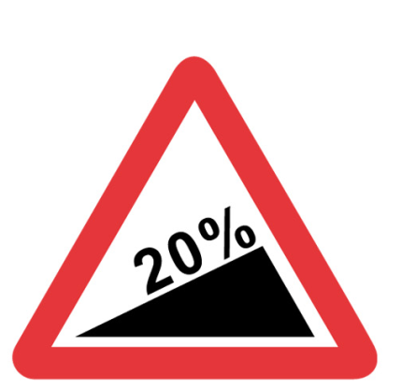




…analyse how things change, or don’t, over time
Historians describe the varying SPEED and SCALE of change
Normally, only some things CHANGE at certain times.
Other things STAY THE SAME.
It is often possible
to identify and analyse
TURNING POINTS
Notes:
Roadsigns?

Slide 10

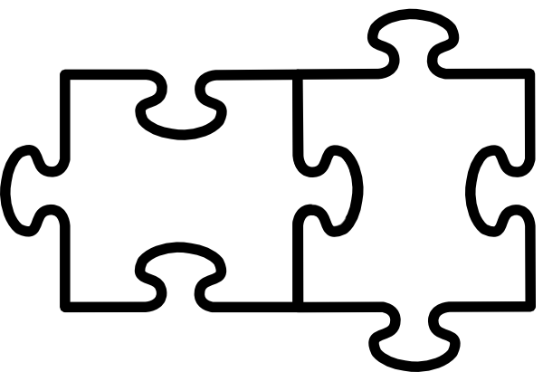
…don’t just quote sources, but unpick the historical evidence within them
Historians make INFERENCES from a variety of sources to explain the past. This means that they think carefully about what the source tells us explicitly as well as what guesses and connections they can make based on the source.
Historical evidence must be COMPARED and COMBINED so that big claims are not based on single pieces of evidence.

Slide 11

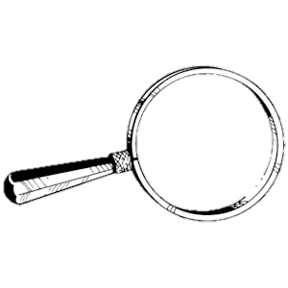
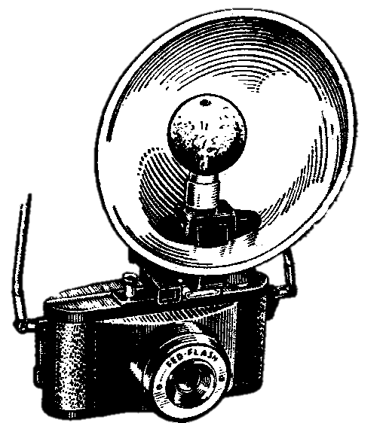
As historical sources are made by people, historians must think carefully about WHO made them, for what PURPOSE and with what AUDIENCE in mind.
The UTILITY (usefulness) of a piece
of historical evidence depends on what TOPIC you are investigating with it.
Every source is useful to historians in some way, but only gives a snapshot in time of a single perspective on the events

Slide 12
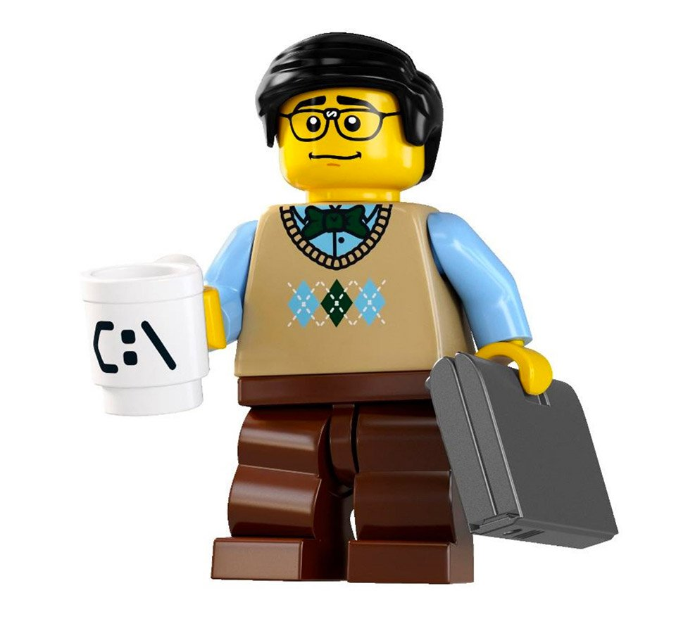

…know that interpretations are deliberately constructed versions of the past after the event
Historical interpretations must be understood with knowledge of the CONTEXT in which they themselves were created
Historians know interpretations are constructed to have a VIEWPOINT, PURPOSE, and a particular AUDIENCE
They should often be judged on the EVIDENCE they have included or, often, have not included.

