Slide 1
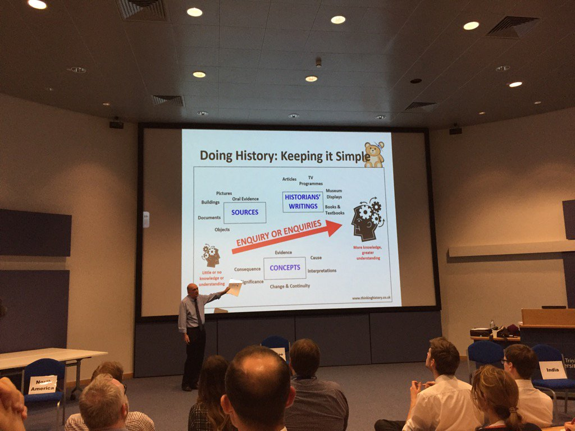
This display was based on Ian Dawson’s suggestions at the HA Northern Forum about the simple messages of doing history. It is aimed at all history students aged 11-18, so maintains a fundamental simplicity.

Slide 2
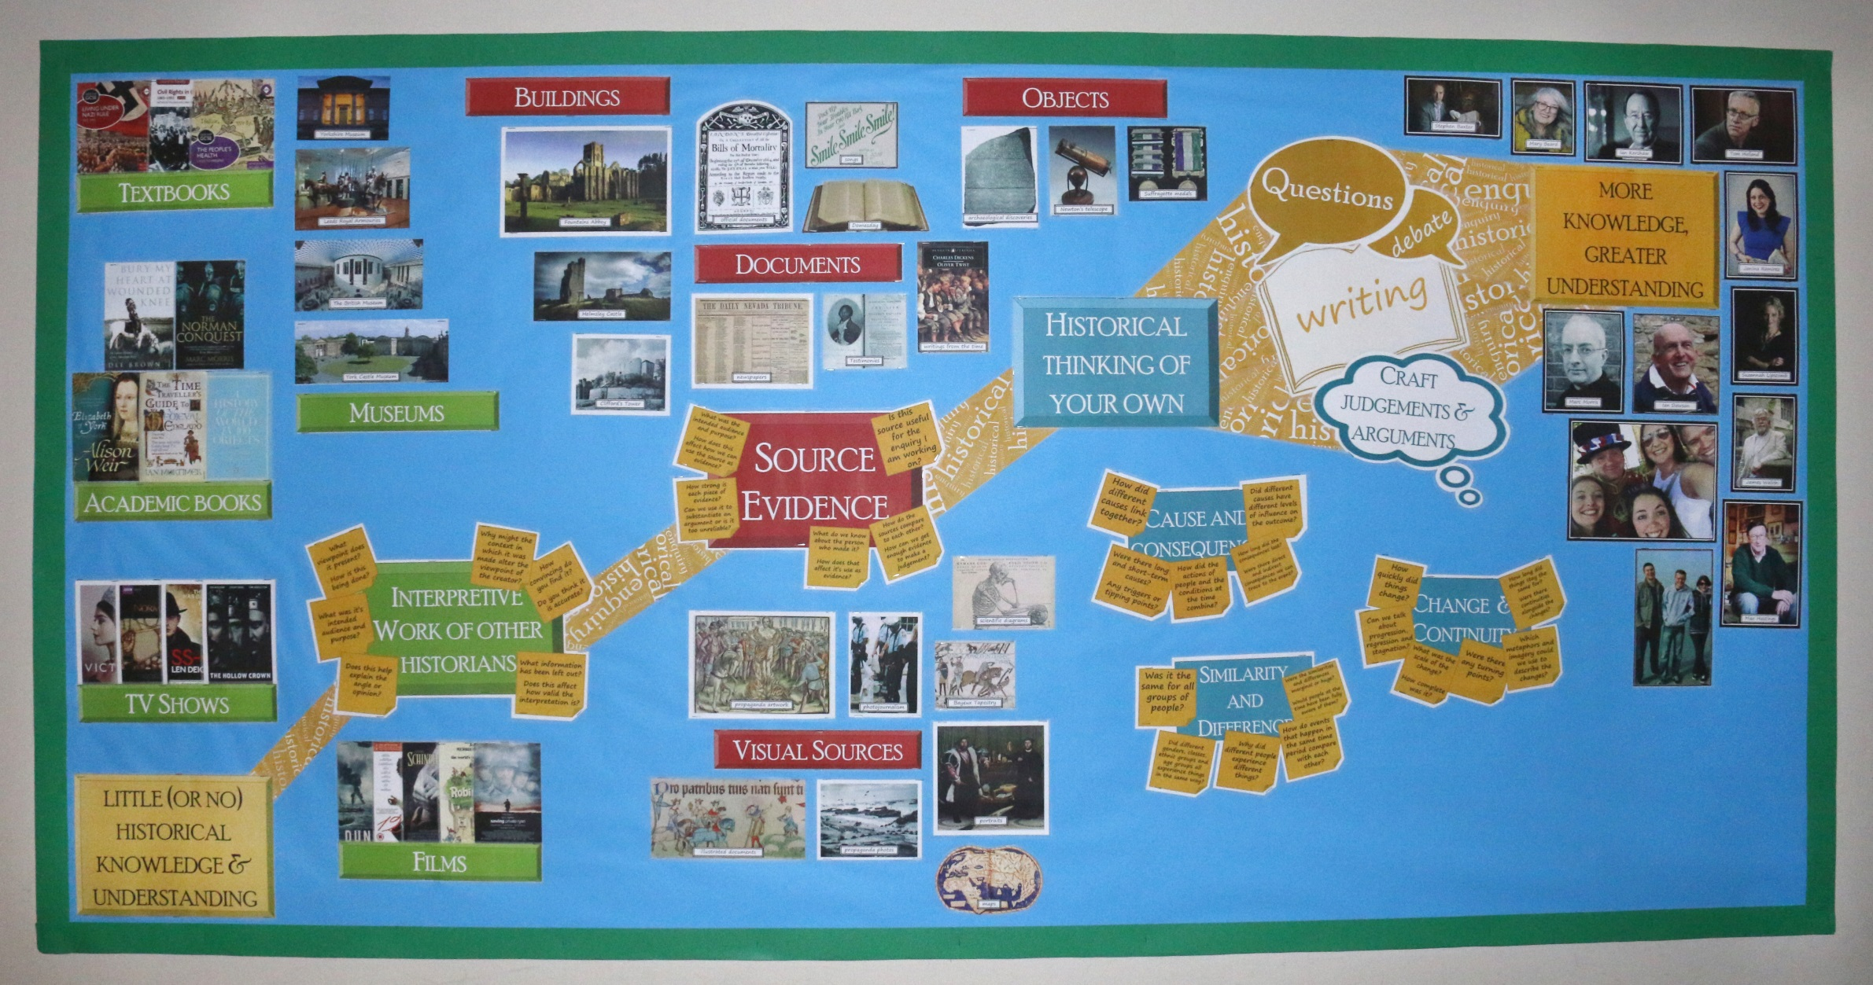
How the display looks in our corridor (based on Ian’s layout- we may yet adapt this if we think we talk more about the process as a sequential one)
PRINT FOR standard display BOARD – all slides in A4 except 15 and 16
Matt laminating is the way forward

Slide 3
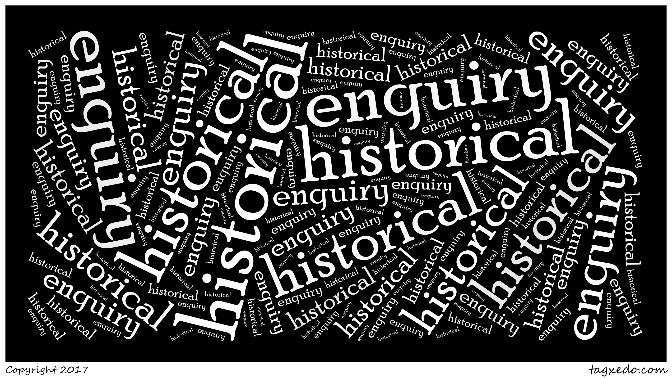
Notes:
Print quite a few of these to form the golden pathway

Slide 4

writing

Slide 5

Craft
judgements & arguments

Slide 6


Questions
debate

Slide 7
more knowledge, greater understanding

Slide 8
little (or no) historical knowledge & understanding

Slide 9
Documents
Other Sources
Objects

Slide 10
Academic books
Buildings
Textbooks

Slide 11
Visual Sources

Slide 12
Films
TV Shows
Museums

Slide 13
Historical thinking of your own

Slide 14
What viewpoint does it present?
How is this being done?
Why might the context in which it was made alter the viewpoint of the creator?
How convincing do you find it?
Do you think it is accurate?
Interpretive
Work of other historians
What was it’s intended audience and purpose?
Does this help explain the angle or opinion?
What information has been left out?
Does this affect how valid the interpretation is?
Notes:
Print a3

Slide 15
What was the intended audience and purpose?
How does this affect how we can use the source as evidence?
Is this source useful for the enquiry I am working on?
Source
Evidence
How strong is each piece of evidence?
Can we use it to substantiate an argument or is it too unreliable?
How do the sources compare to each other?
How can we get enough evidence to make a judgement?
What do we know about the person who made it?
How does that affect it’s use as evidence?
Notes:
PRINT A3

Slide 16
How did different causes link together?
Did different causes have different levels of influence on the outcome?
Cause and consequence
How long did the consequences last?
Were there direct and indirect consequences we can trace to the event?
Were there long- and short-term causes?
Any triggers or tipping points?
How did the actions of people and the conditions at the time combine?
Notes:
PRINT A4

Slide 17
Similarity
and Difference
Was it the same for all groups of people?
Were the similarities and differences marginal or huge?
Would people at the time have been fully aware of them?
How do events that happen in the same time period compare with each other?
Did different genders, classes, ethnic groups and age groups all experience things in the same way?
Why did different people experience different things?
Notes:
PRINT A4

Slide 18
How quickly did things change?
How long did things stay the same for?
Were there continuities alongside the changes?
Change & Continuity
Can we talk about progression, regression and stagnation?
Which metaphors and imagery could we use to describe the changes?
Were there any turning points?
What was the scale of the change?
How complete was it?
Notes:
PRINT A4

Slide 19
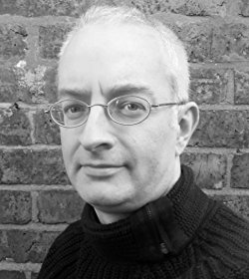
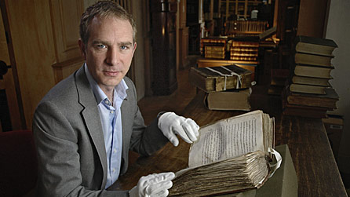
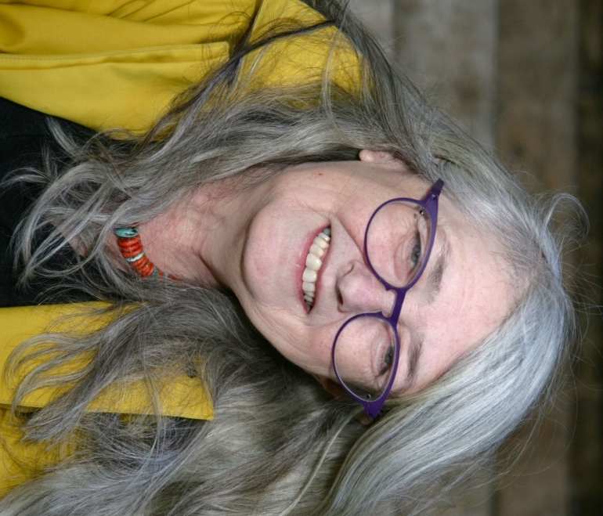
Stephen Baxter
Marc Morris
Mary Beard

Slide 20
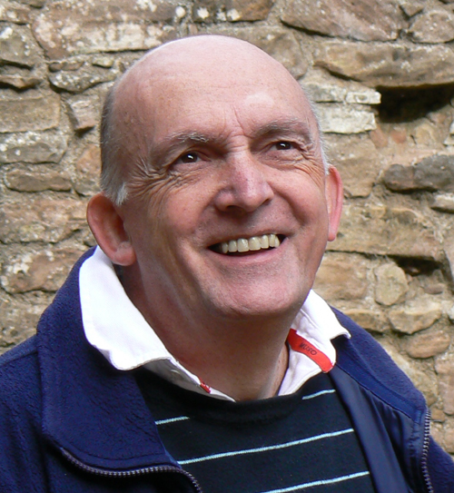
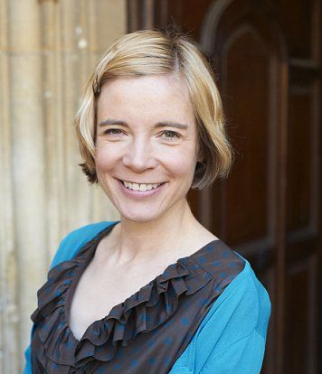
Lucy Worsley
Ian Dawson

Slide 21
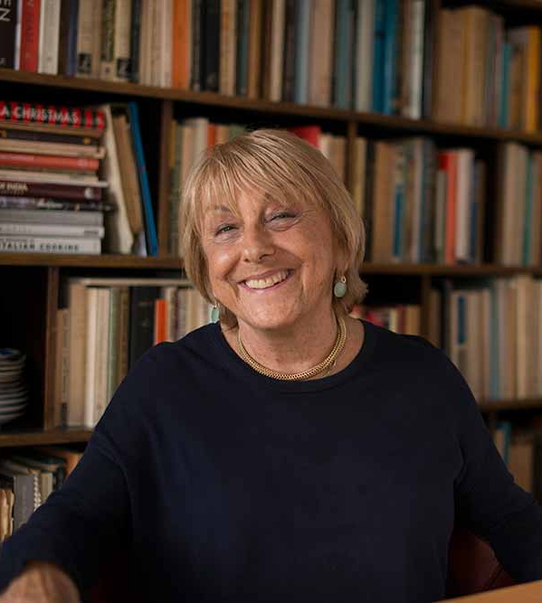
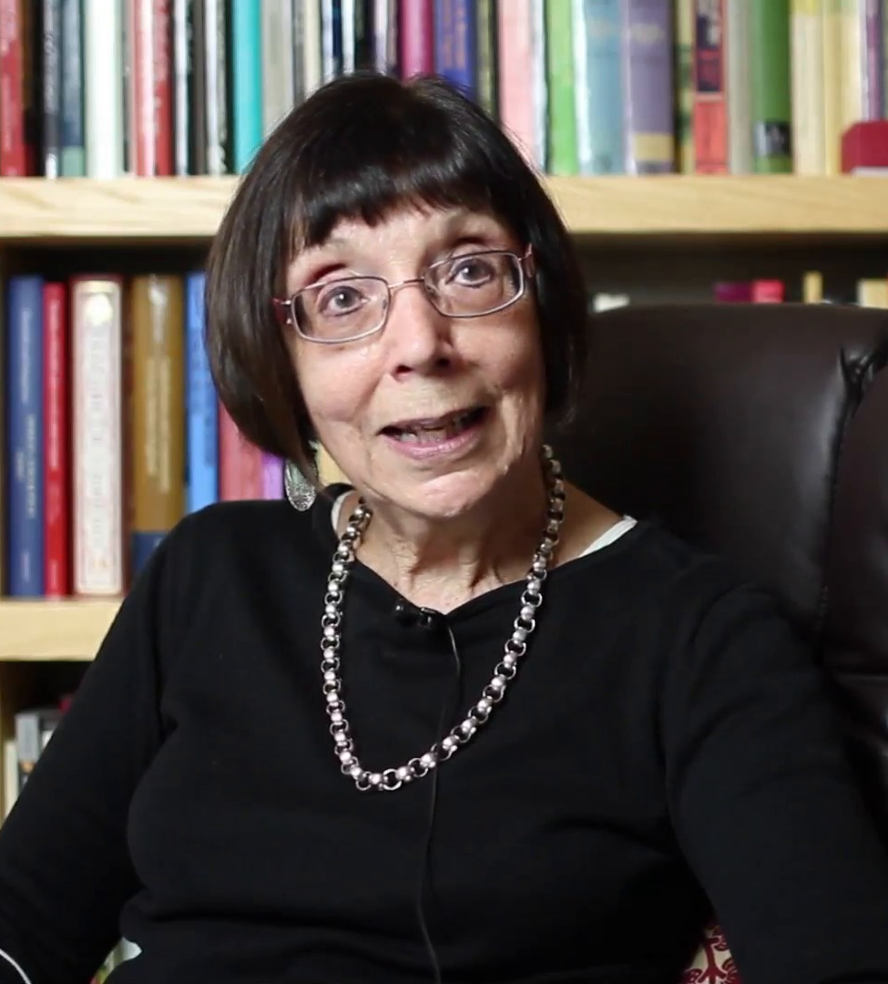
Lisa Jardine
Susan Doran

Slide 22
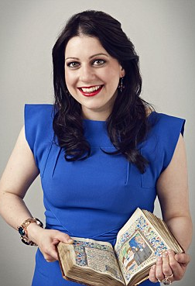
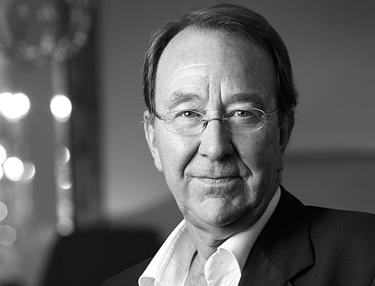
Ian Kershaw
Janina Ramirez

Slide 23
Include a photo of your history teachers here!

Slide 24
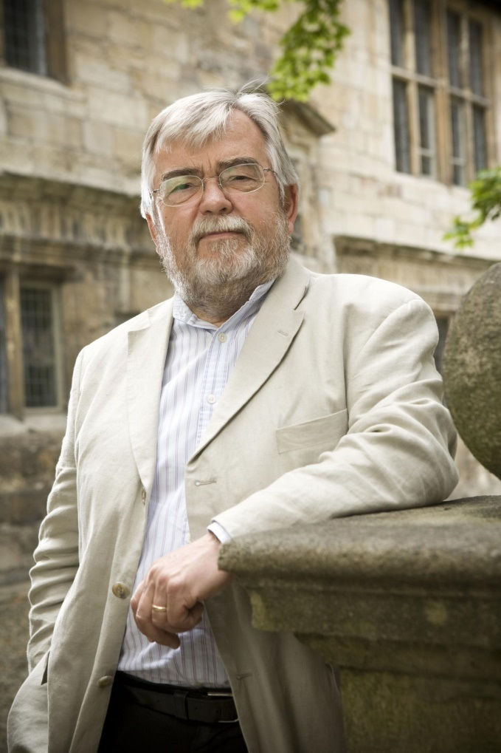

James Walvin
Suzannah Lipscomb

Slide 25
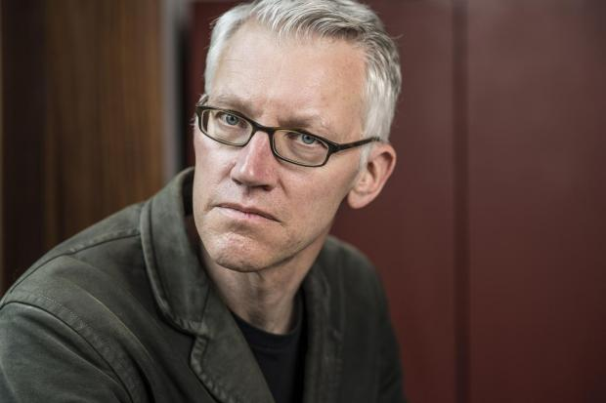
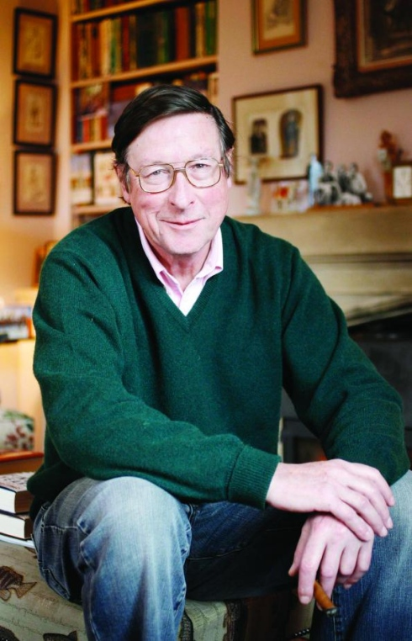
Tom Holland
Max Hastings

Slide 26
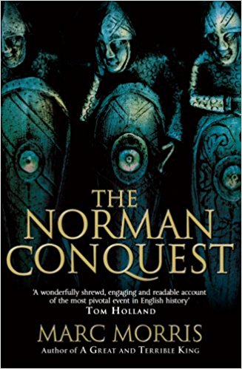


Slide 27



Slide 28

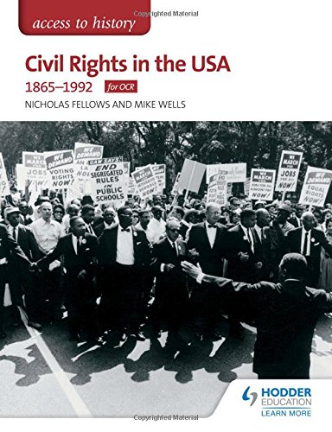

Slide 29



Slide 30
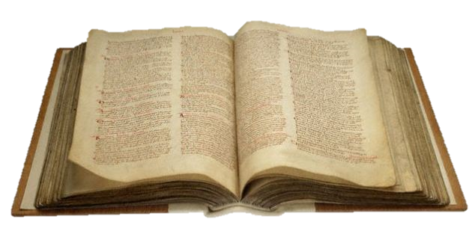
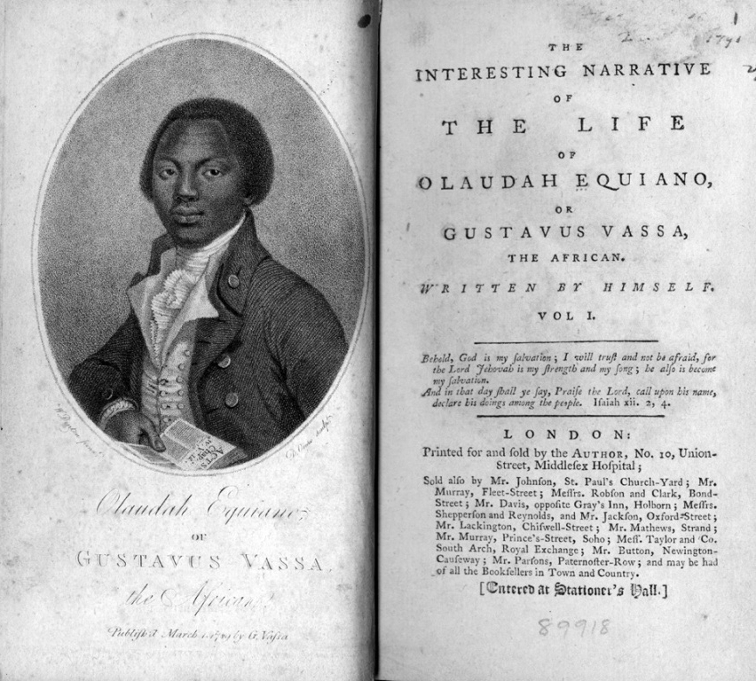
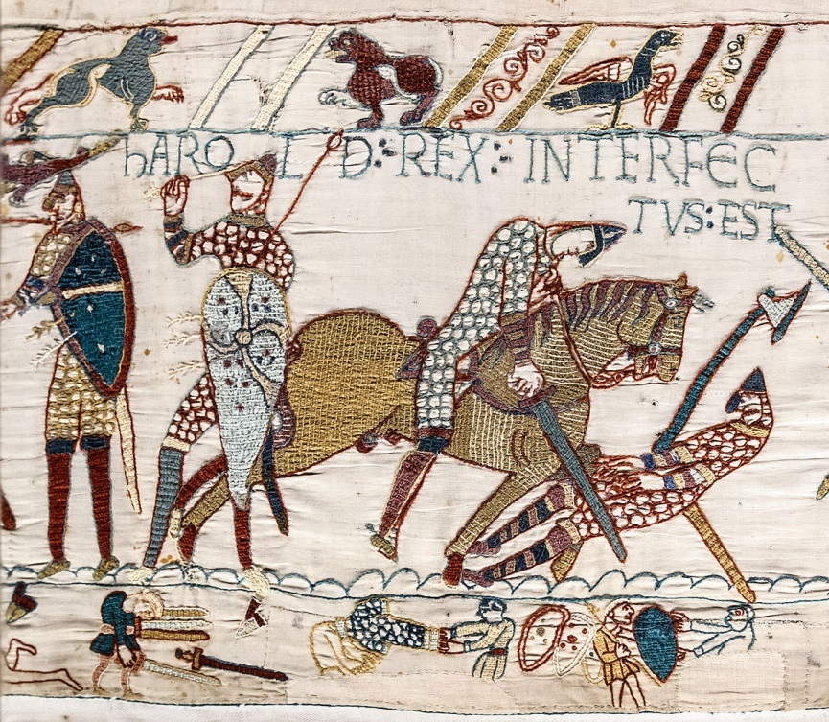
Domesday
Testimonies
Bayeux Tapestry

Slide 31
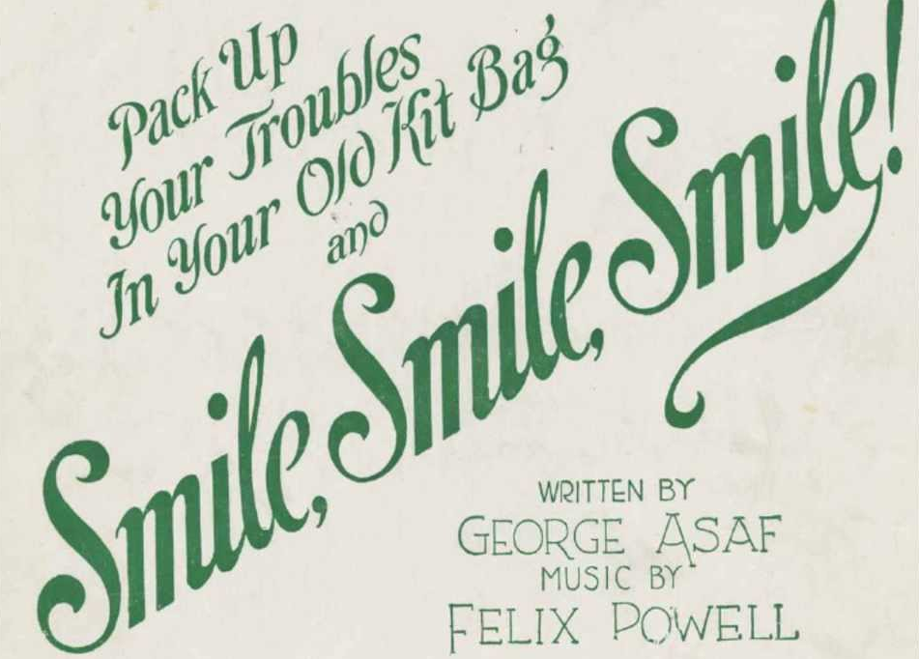

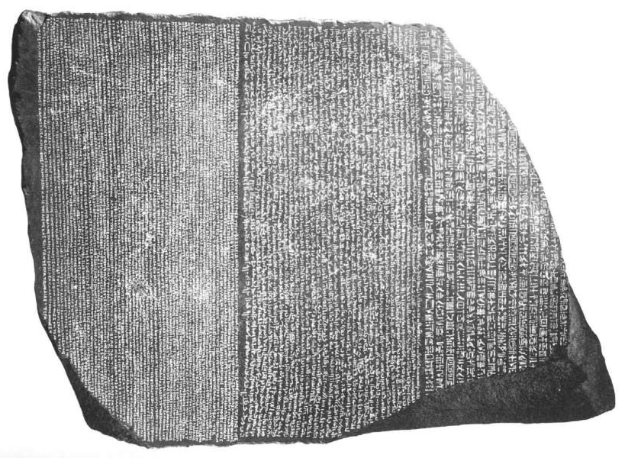
songs
archaeological discoveries
writings from the time

Slide 32
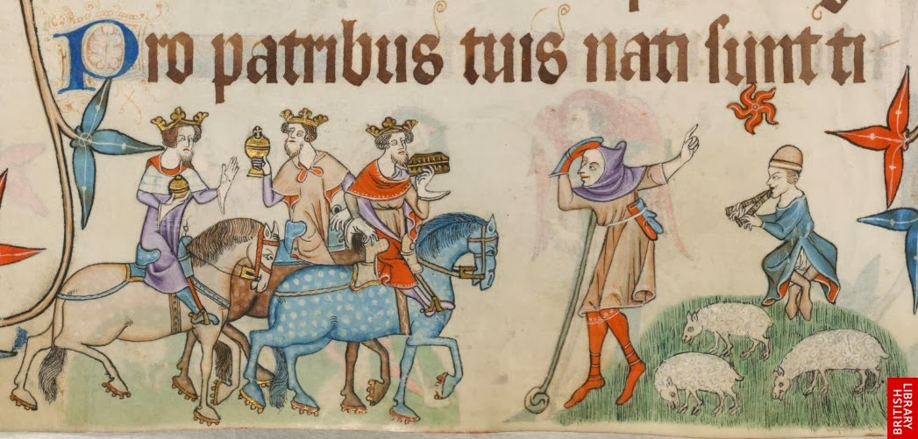
illustrated documents

Slide 33
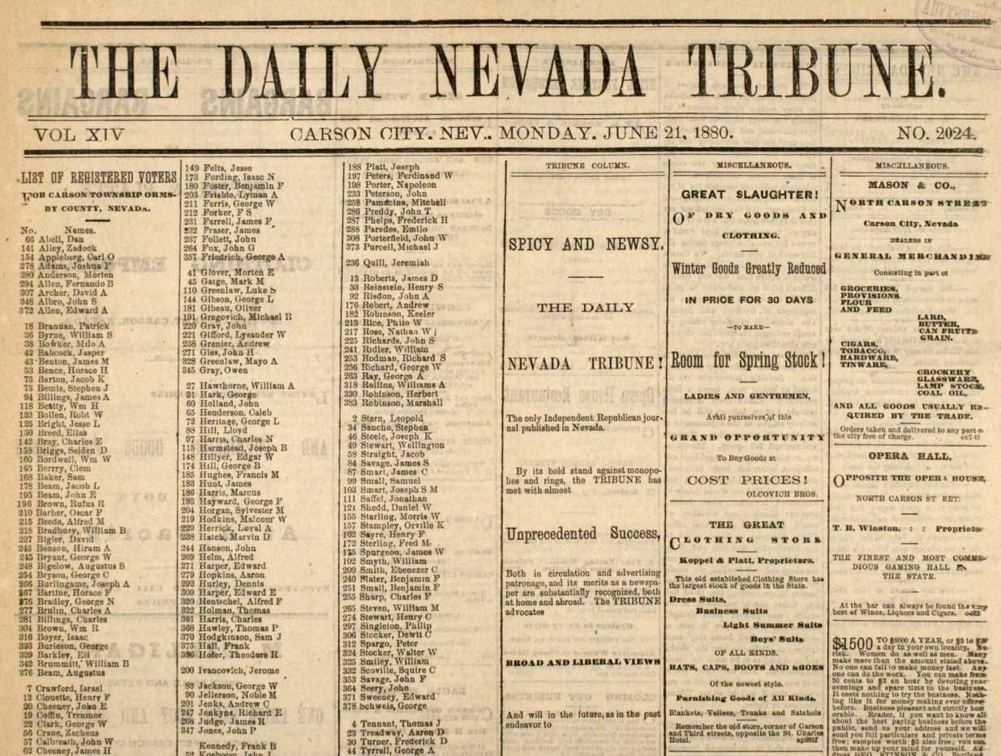
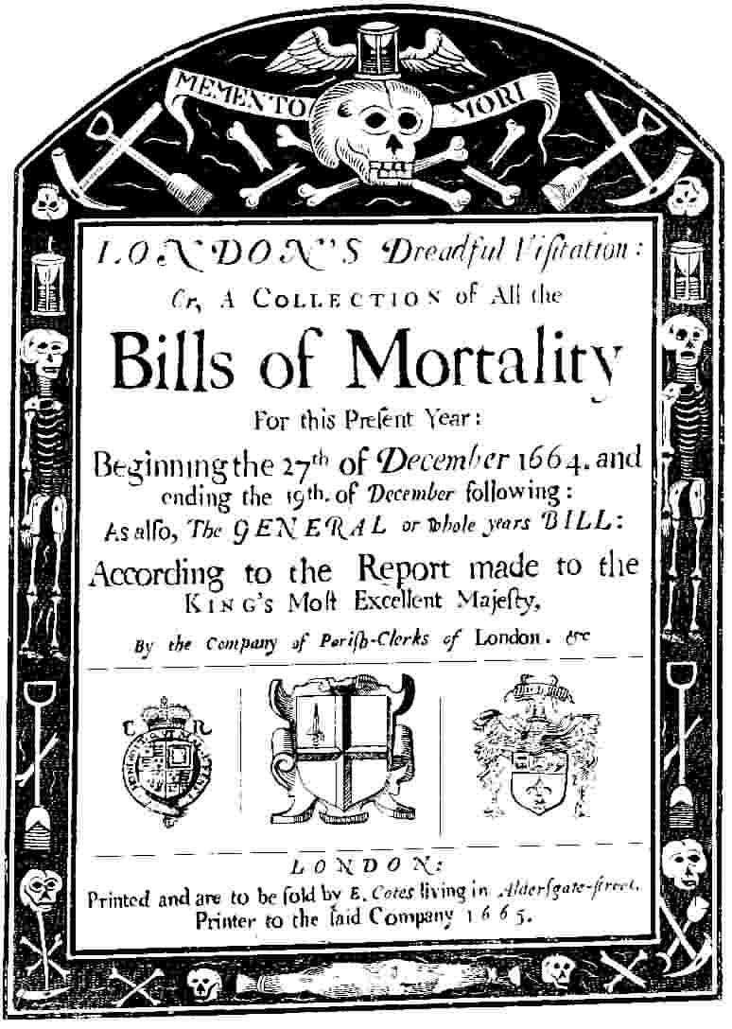
newspapers
official documents

Slide 34
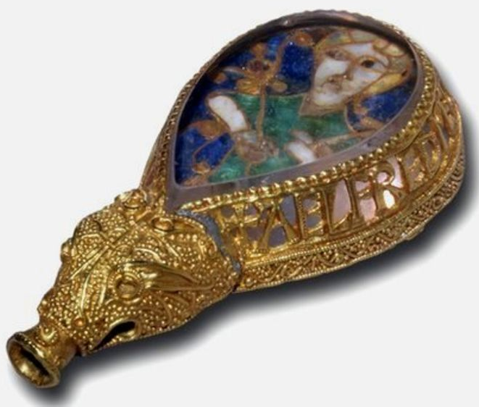
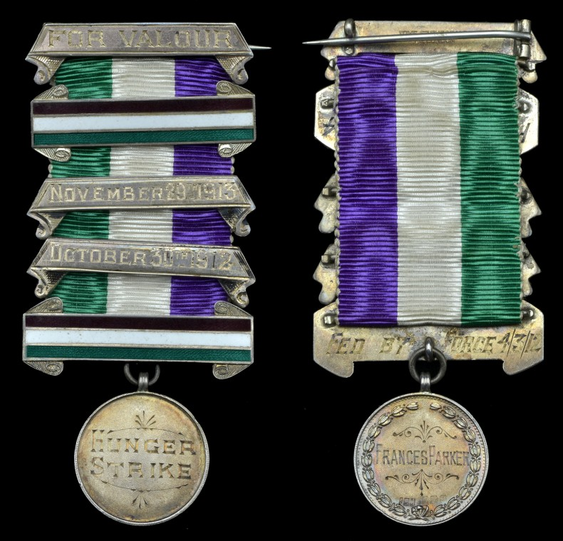
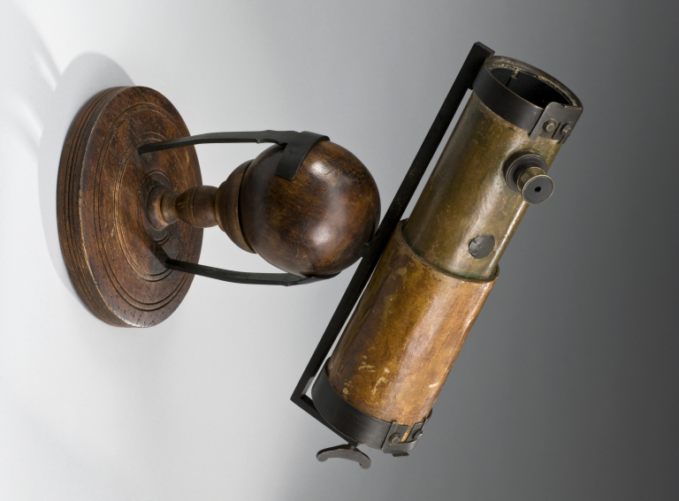
Objects and artefacts
Suffragette medals
Newton’s telescope

Slide 35
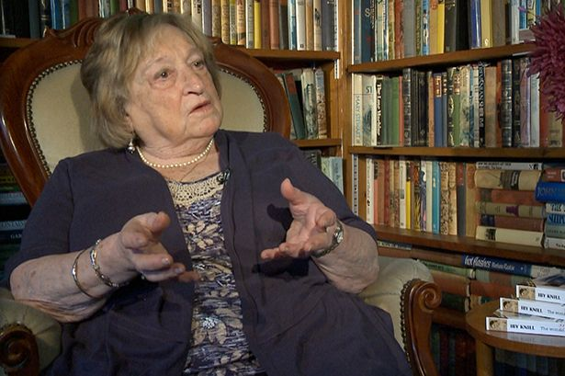


survivor testimony

Slide 36




Slide 37

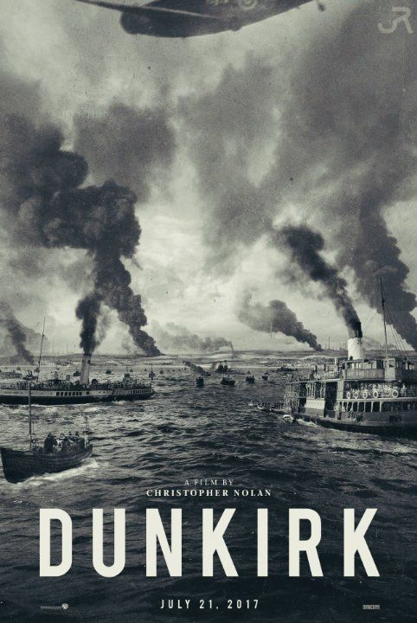

Slide 38
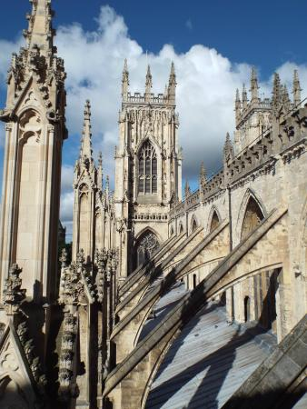
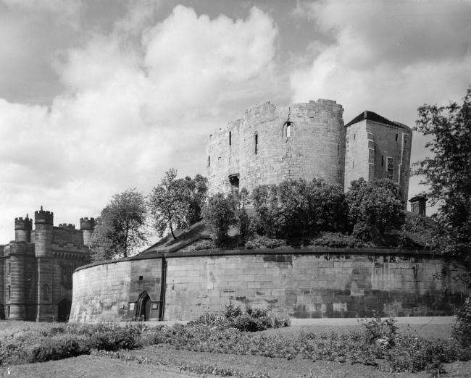
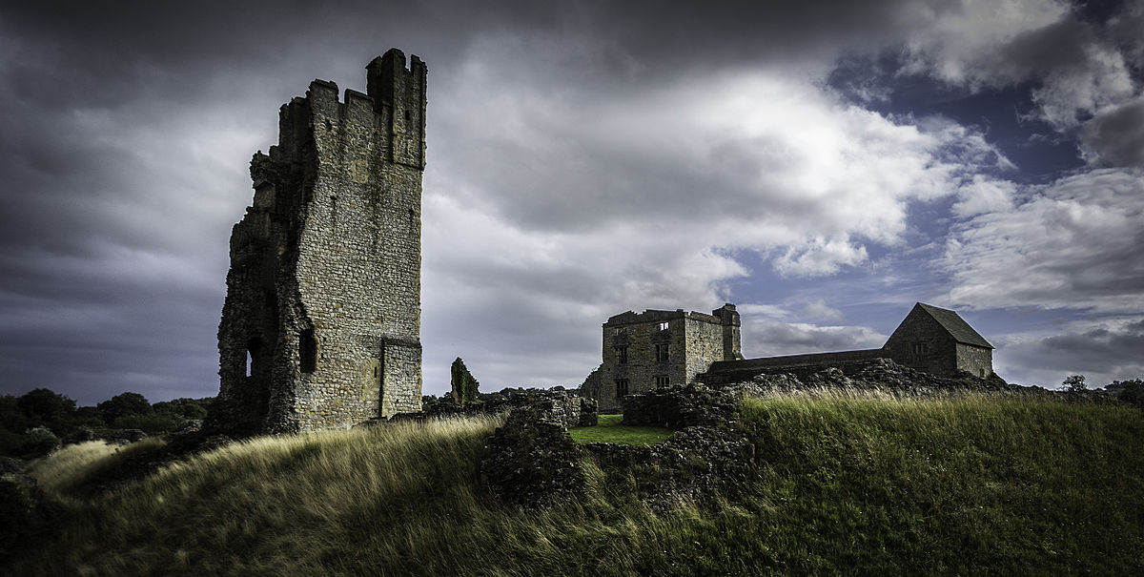
Clifford’s Tower
York Minster
Helmsley Castle

Slide 39
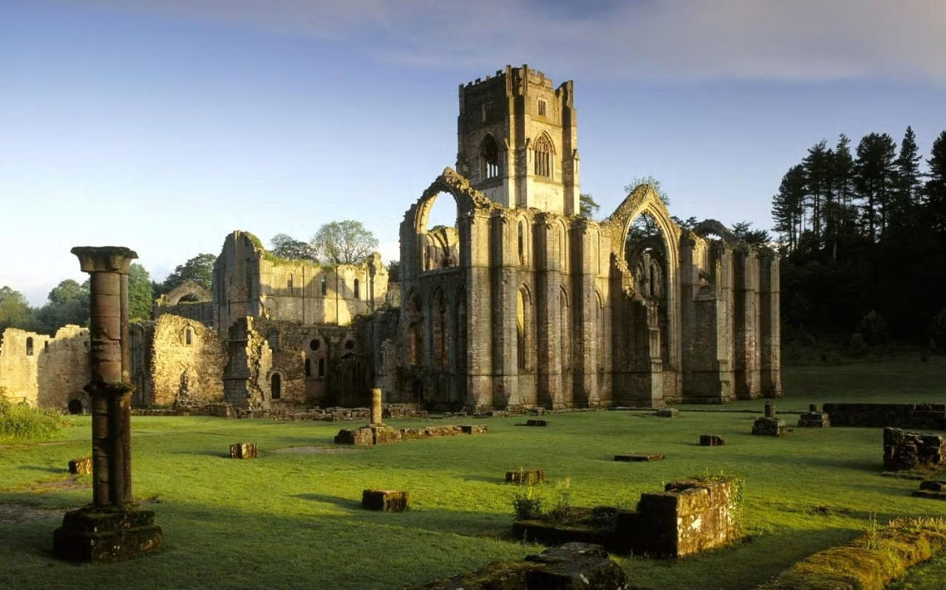
Fountains Abbey

Slide 40
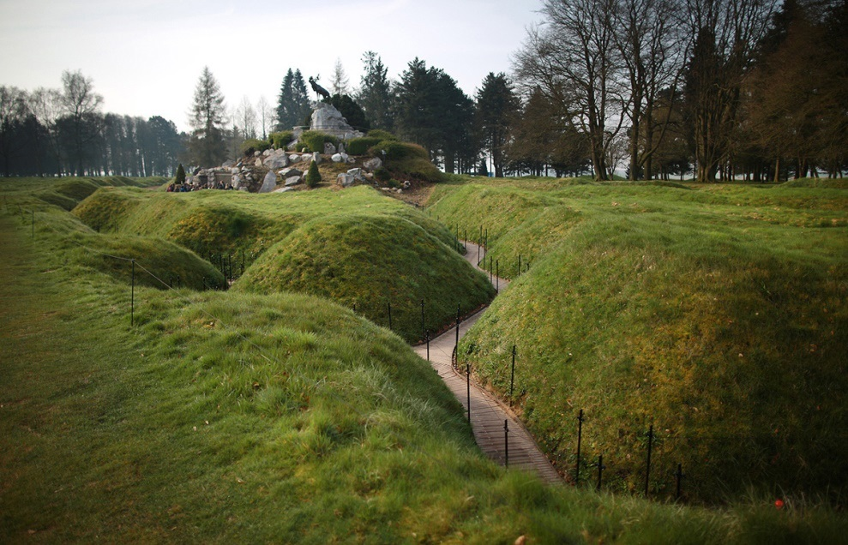
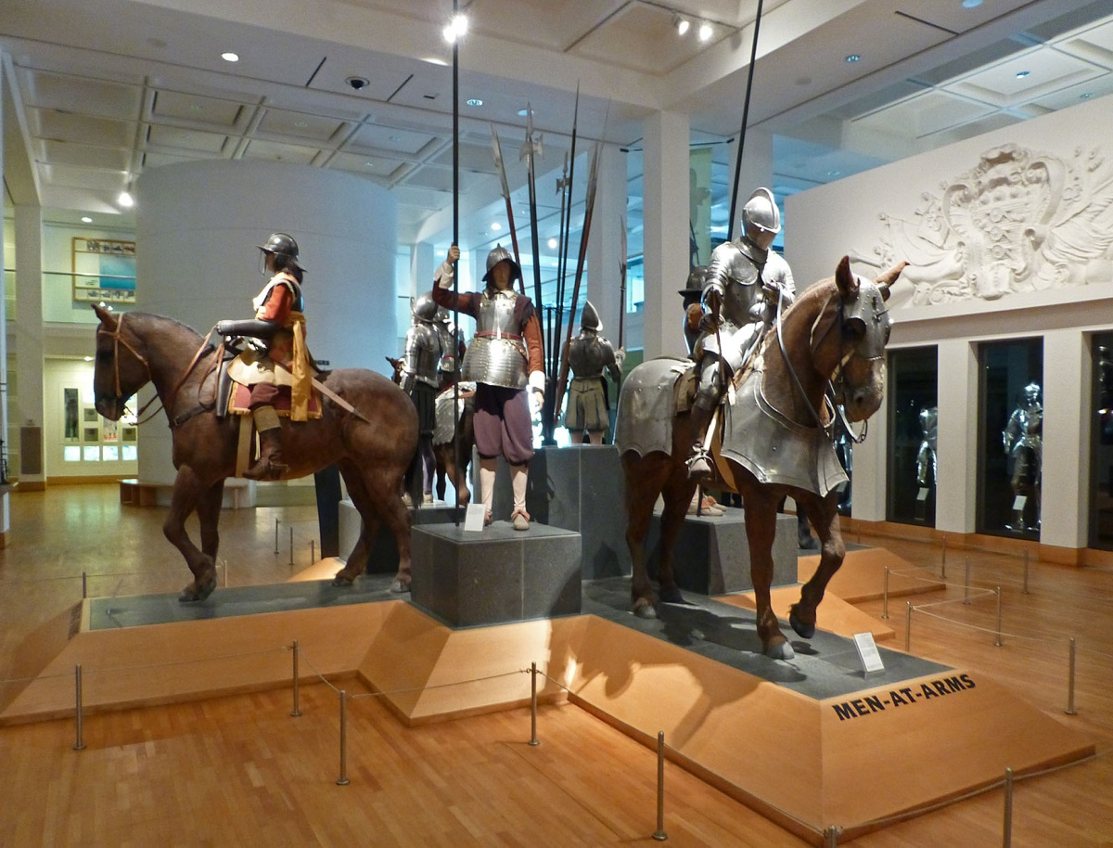
Beaumont Hamel
Leeds Royal Armouries

Slide 41
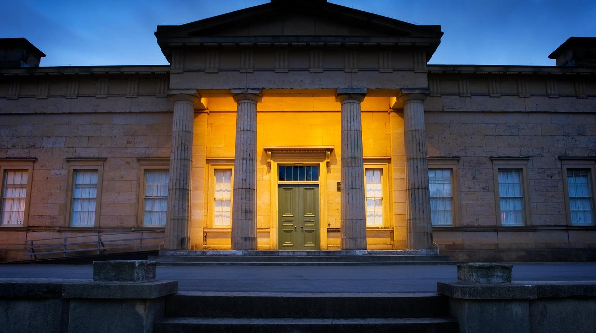
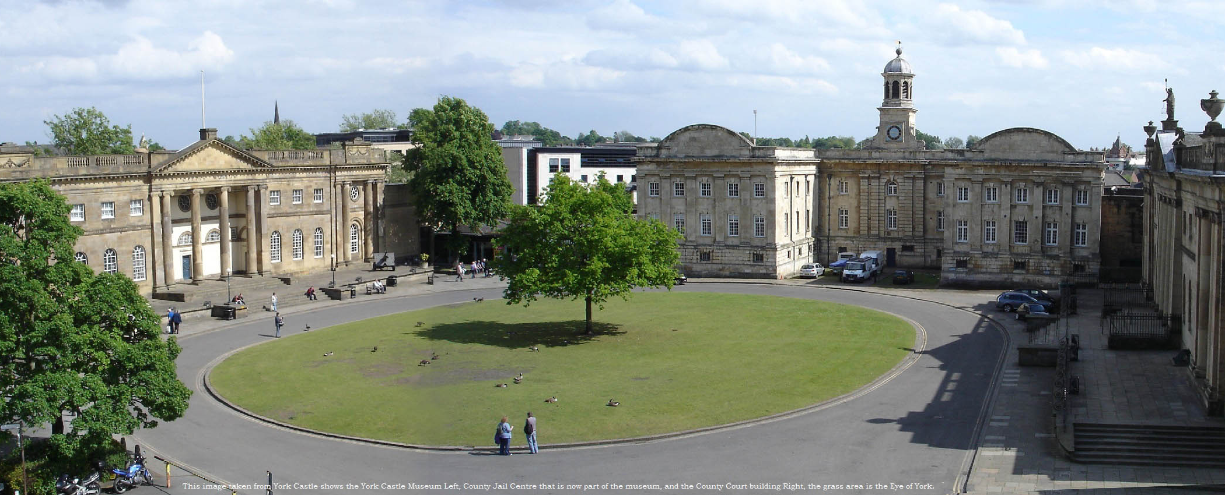
Yorkshire Museum
York Castle Museum

Slide 42
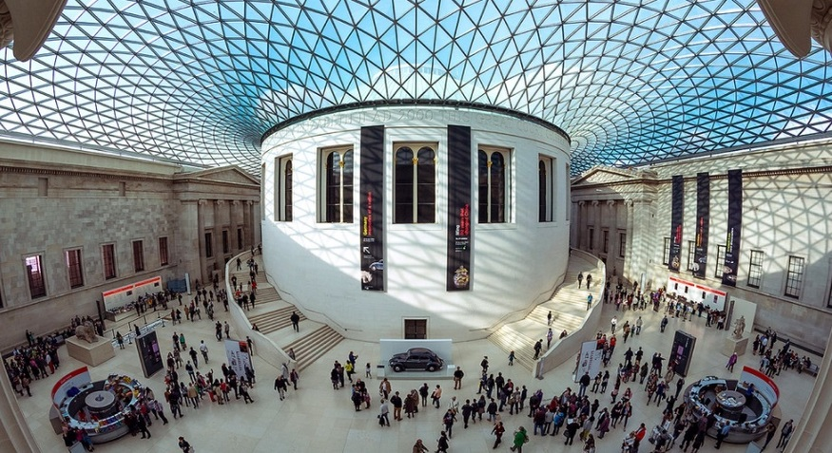
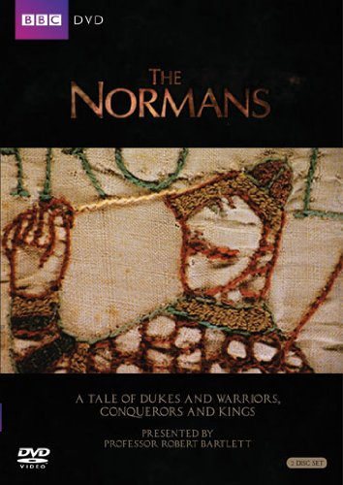

The British Museum

Slide 43
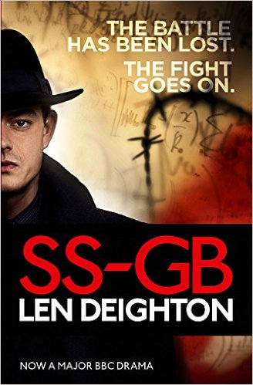

TV dramatic adaptions
historical fiction

Slide 44
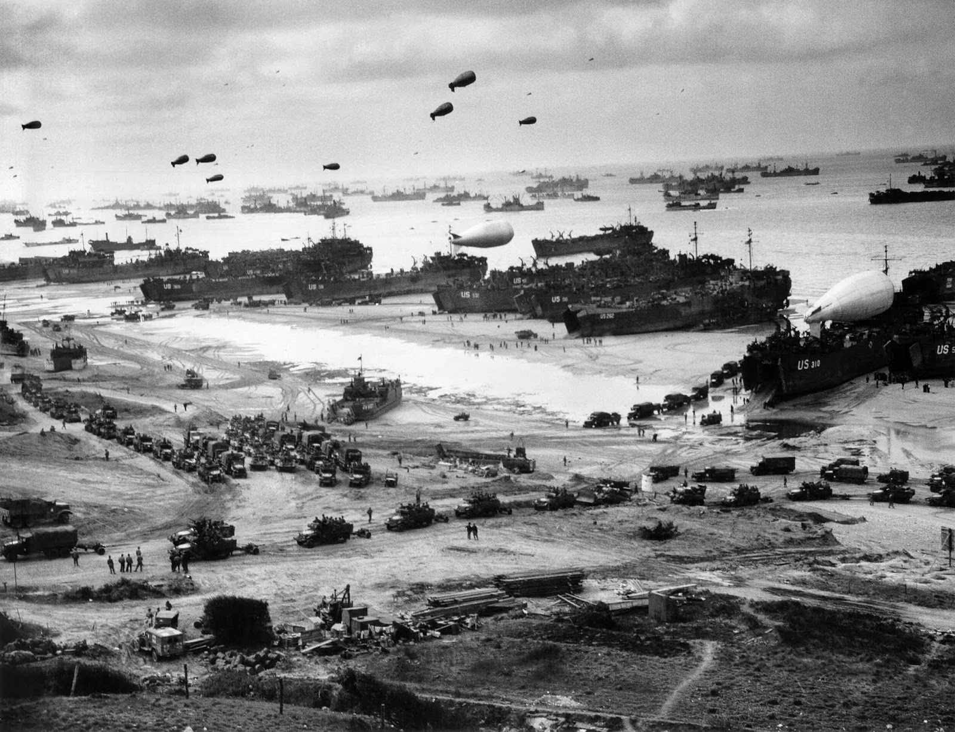
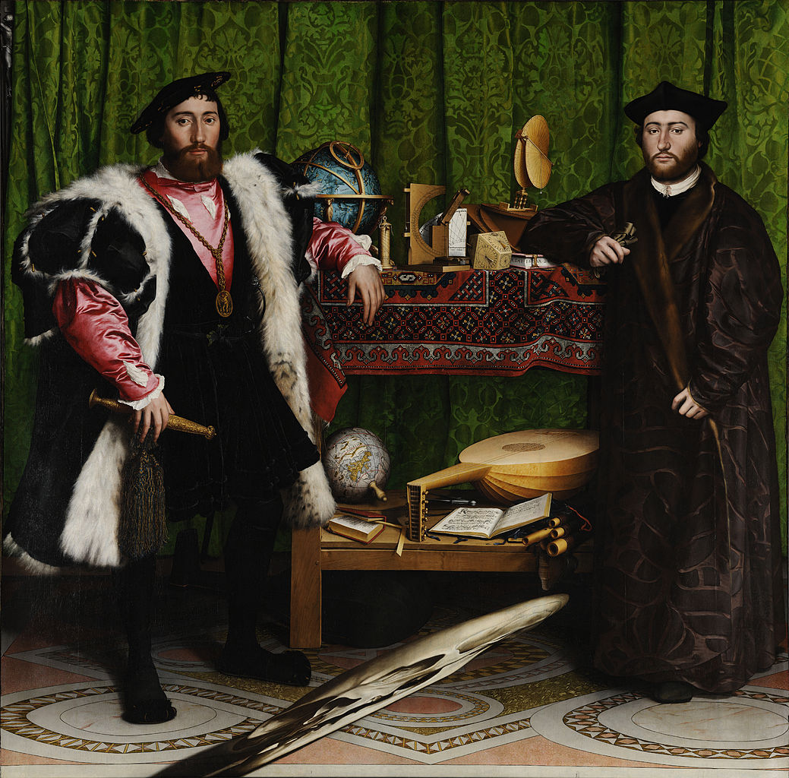

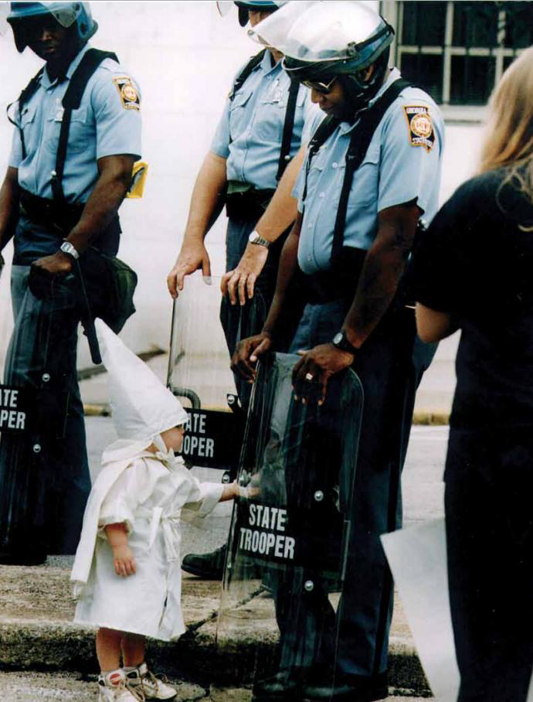
propaganda photos
portraits
photojournalism

Slide 45
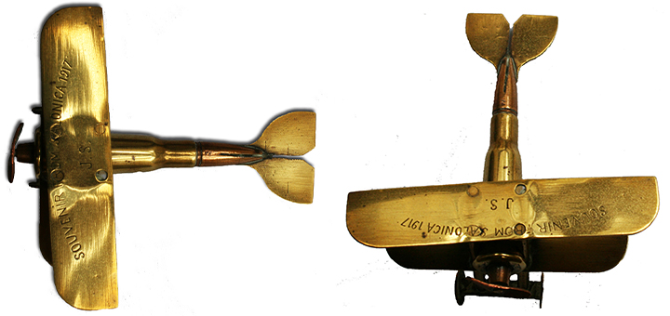
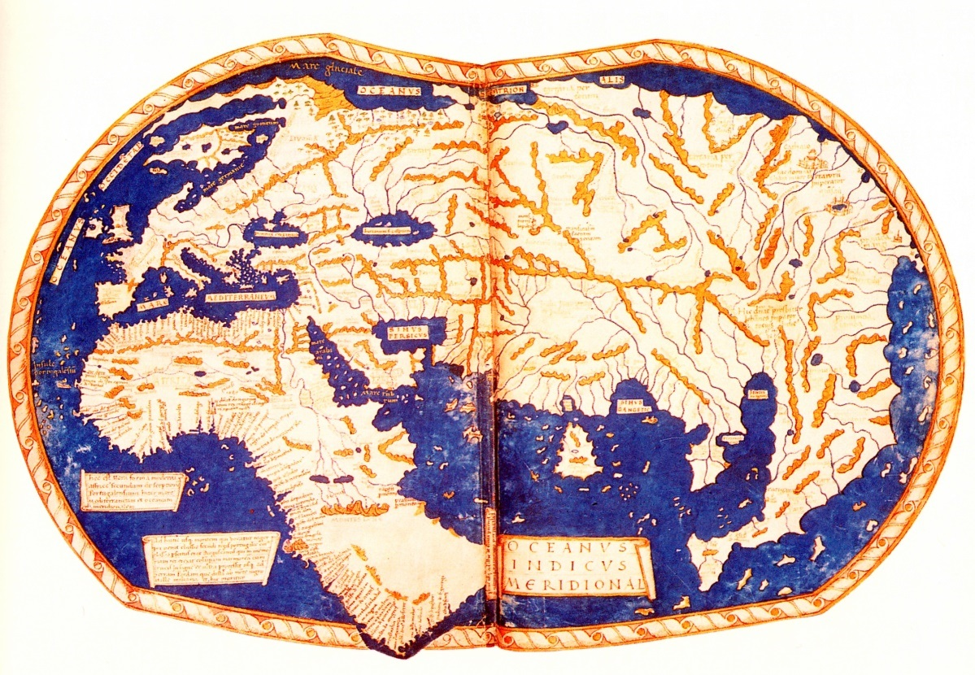
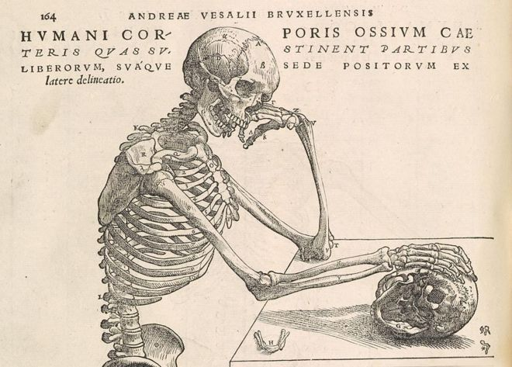
other artwork
maps
scientific diagrams

Slide 46
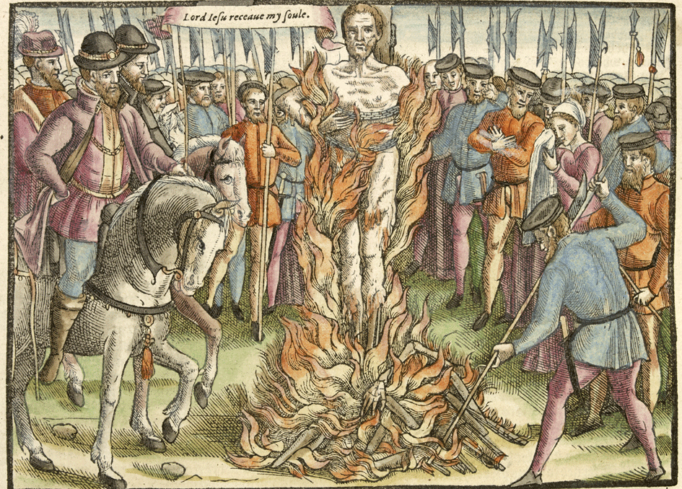
propaganda artwork

