Slide 1
The Old Lady in the Post Office
Slide 2: for incorporation into PPTs
Slide 3: print as handout
@MisterHistry

Slide 2
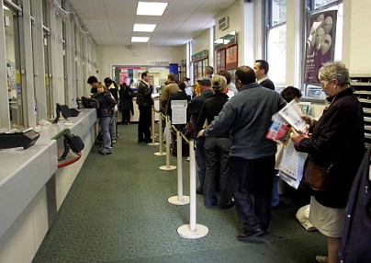
“Excuse me, are you the manager? Good. This queue really is the worst thing about this Post Office!
The queue is so long is has been snakin’ out the door for the past half hour an’ it’s not getting any shorter. I only came in here to post a few letters but it’s taken me ages just standing here in the queue!
And another thing! If that stamp machine wasn’t broken I’d ‘ave been able to get out of here far quicker. I only need a few stamps for these letters! If that machine had been workin’ I wouldn’t have had to queue for so long!
And even then, after I’d been waiting in the queue, I got to the front and the man behind the counter was very rude to me. No pleases or thank yous, just here’s-your-stamp and let’s-’ave -some money! Mind you, if the queue wasn’t so long he might have had the time to give me a smile and a thank you!
Really, if you just sorted out that queue it wouldn’t be so difficult and people wouldn’t be getting so angry!”
The Old Lady in the Post Office: a monologue.
(volunteers with an ‘angry old lady’ voice?)
What issues does she raise?
Which is her main problem?
How can you tell?

Slide 3
The Old Lady in the Post Office: a monologue.
“Excuse me, are you the manager? Good. This queue really is the worst thing about this Post Office!
The queue is so long is has been snakin’ out the door for the past half hour an’ it’s not getting any shorter. I only came in here to post a few letters but it’s taken me ages just standing here in the queue!
And another thing! If that stamp machine wasn’t broken I’d ‘ave been able to get out of here far quicker. I only need a few stamps for these letters! If that machine had been workin’ I wouldn’t have had to queue for so long!
And even then, after I’d been waiting in the queue, I got to the front and the man behind the counter was very rude to me. No pleases or thank yous, just here’s-your-stamp and let’s-’ave -some money! Mind you, if the queue wasn’t so long he might have had the time to give me a smile and a thank you!
Really, if you just sorted out that queue it wouldn’t be so difficult and people wouldn’t be getting so angry!”
The Old Lady in the Post Office: a monologue.
“Excuse me, are you the manager? Good. This queue really is the worst thing about this Post Office!
The queue is so long is has been snakin’ out the door for the past half hour an’ it’s not getting any shorter. I only came in here to post a few letters but it’s taken me ages just standing here in the queue!
And another thing! If that stamp machine wasn’t broken I’d ‘ave been able to get out of here far quicker. I only need a few stamps for these letters! If that machine had been workin’ I wouldn’t have had to queue for so long!
And even then, after I’d been waiting in the queue, I got to the front and the man behind the counter was very rude to me. No pleases or thank yous, just here’s-your-stamp and let’s-’ave -some money! Mind you, if the queue wasn’t so long he might have had the time to give me a smile and a thank you!
Really, if you just sorted out that queue it wouldn’t be so difficult and people wouldn’t be getting so angry!”

