Slide 1
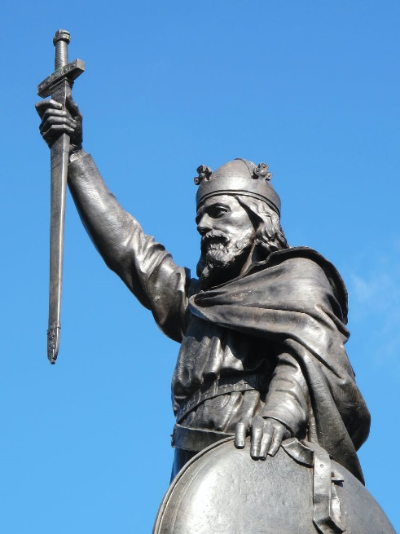
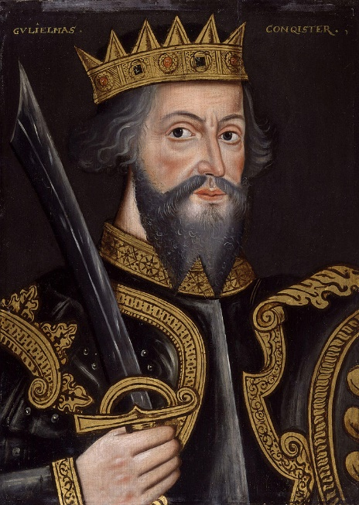
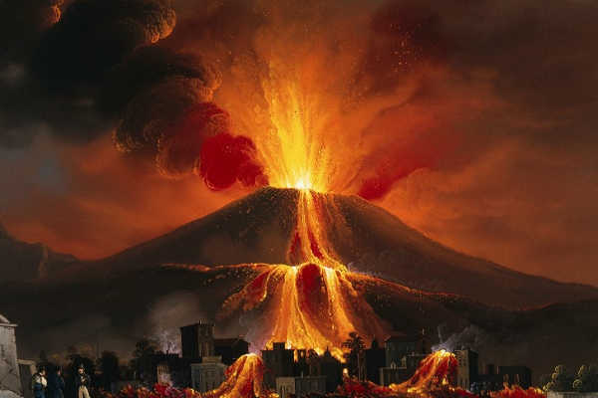
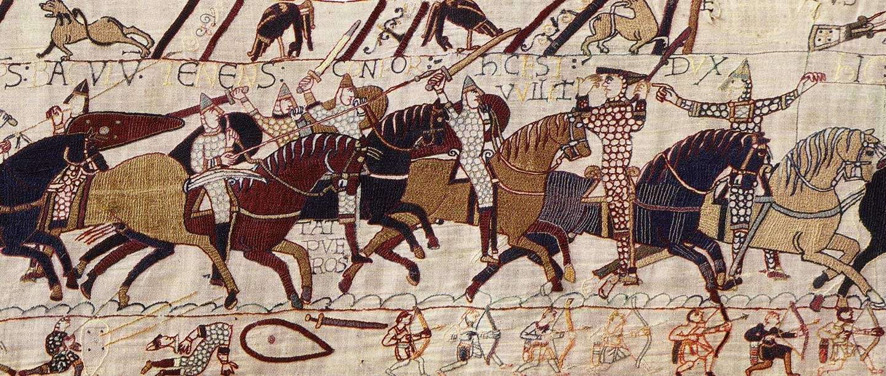
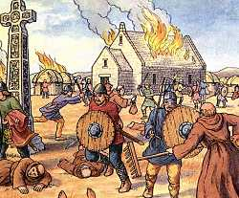
Thinking point: Why have these events/ individuals ended up being written about by historians, in your school curriculum and on television shows? Why do we talk about them?
The eruption of Pompeii
Alfred the Great
William the Conqueror
Battle of Hastings
Viking invasions

Slide 2
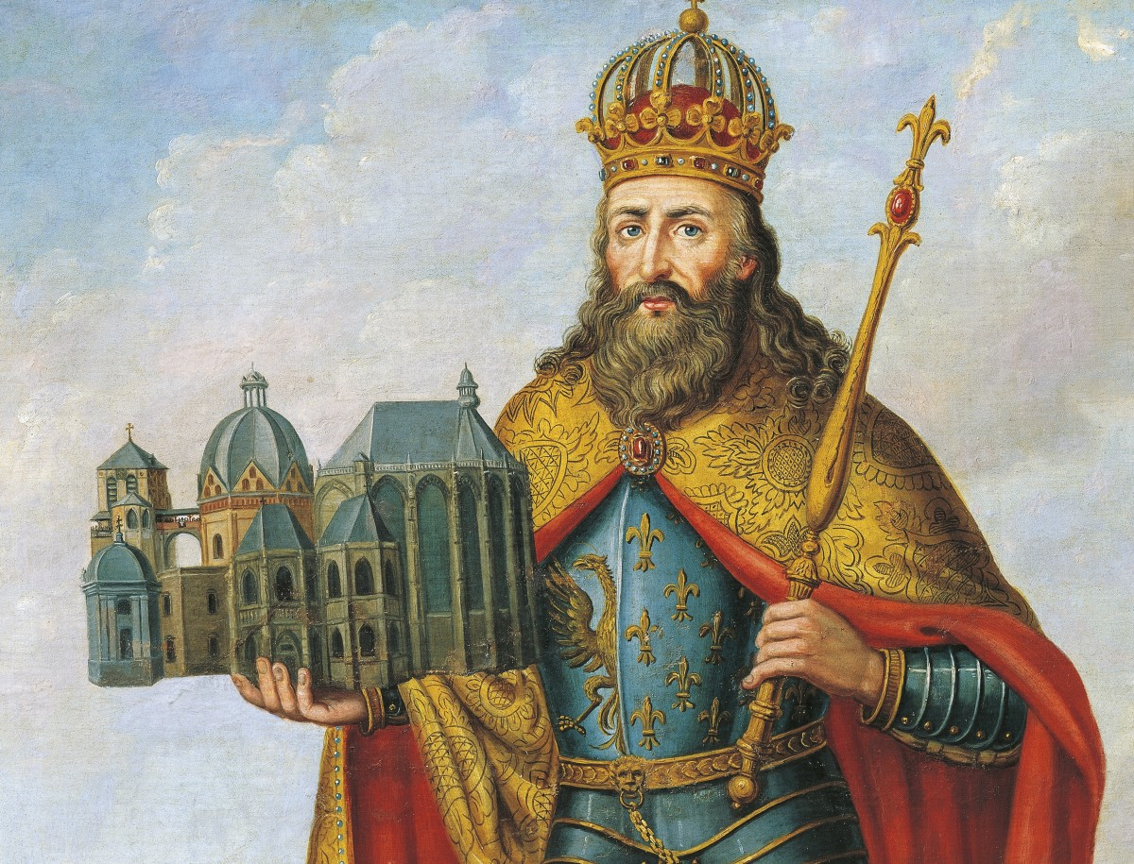
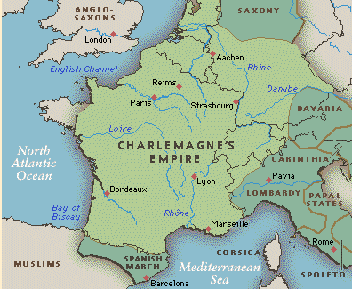
Thinking point: Your history teacher could have taught you about….
Charlemagne
Charlemagne (2 April 748[4] – 28 January 814) was the King of the Franks from 768, the King of the Lombards from 774, and the Emperor of the Romans from 800. During the Early Middle Ages, he united the majority of western and central Europe.
But we didn’t…. why? Because we decided that it was more important for you to understand Anglo-Saxon England so you could understand Medieval England better.
Were we right to do this? A *huge* question and a big debate!

Slide 3
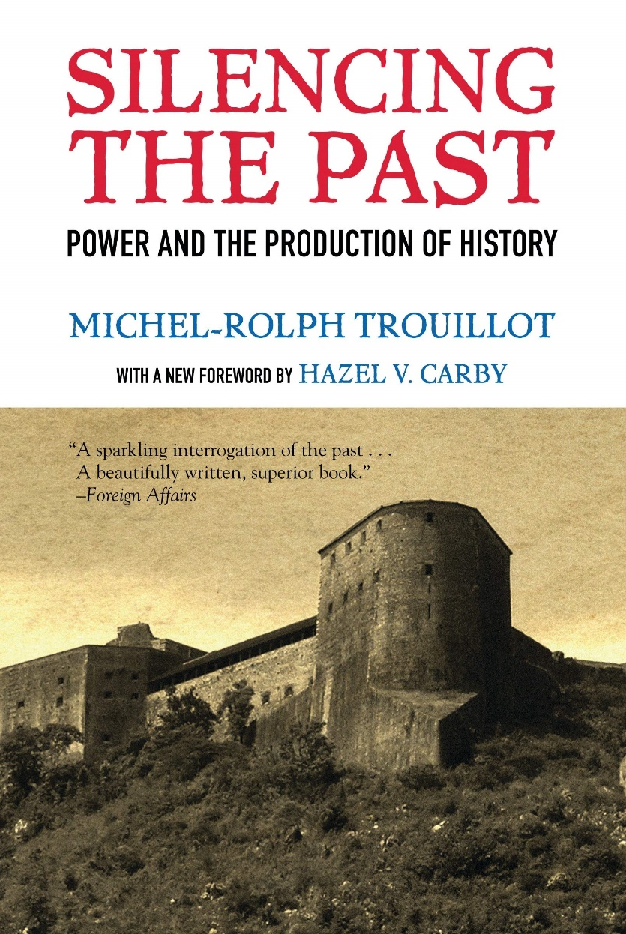
Thinking point: Significance
There are so many events and people in history that it is impossible for us to tell you about them all.
All your history teachers studied history for 3 years and we still only learnt a tiny number of the events and people from history.
So why have some events and people become more talked about, more written about?... It’s because they’ve been seen as historically significant.
We DO NOT have the right to judge events as historical significant or not
BUT we need to think about why some events and people have been seen as significant and why others have been forgotten (or ‘silenced’)

Slide 4
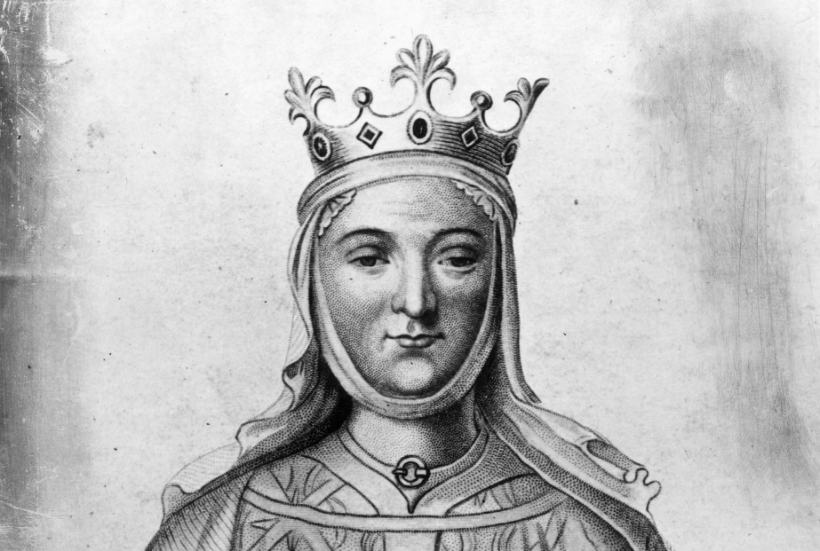
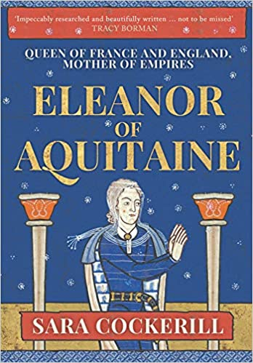
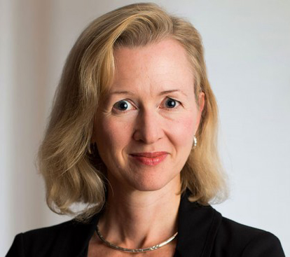
Input: Significance
In this enquiry, we are going to be focussing on one reason why historians have thought people from the past are significant.
Sometimes studying an important person reveals a lot about life in a period. The extraordinary can reveal lots about the ordinary! This makes such people useful to historians. Through the study of an individual we can get a window into what power and authority meant to people in the 12th century.
Eleanor of Aquitaine’s story has been written about so much it is really important for historians to work out actually what happened during her reign so we can understand what her story actually reveals. This is what Sara Cockerill has done in her latest book on Eleanor.

Slide 5

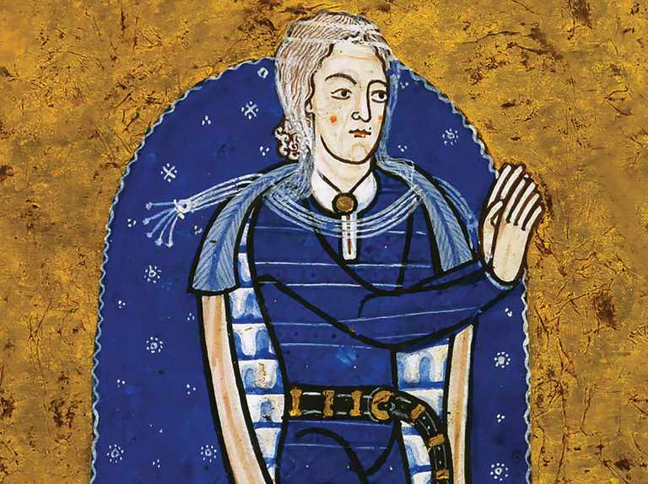
Today, we are going to start our next enquiry!
Please write down the title for that new enquiry in BIG BOLD LETTERS:
EQ: What can the story of Eleanor of Aquitaine reveal about high Middle Ages?

